Slide 1
Introduction to machine learning
ML Pipeline
R. Brooks

Slide 2
















The Machine Learning Pipeline
Look at the big picture.
Get the data.
Discover and visualize the data to gain insights.
Prepare the data for Machine Learning algorithms.
Select a model and train it.
Fine-tune your model.
Present your solution
Launch, monitor, and maintain your system.
Test data
Model requirements
Metrics
Raw data
Training data
Predictions
Trained model
Requirements
Data
Data
Predictive
Evaluation
Deployment
Analysis
Acquisition
Preparation
Modelling
Icons made by Smashicons from www.flaticon.com
Business metrics
Acceptance criteria
Data protection
Ethics
Interpretability requirements
Exploration
Quality assessment
Cleansing
Labeling
Imputation
Feature engineering
Algorithm selection
Feature selection
Model training
Hyperparameter tuning
Model selection
Evaluation Metrics
Inspection
Interpretation
Manual evaluation
Model compression
Model versioning
Process integration
Monitoring
Online learning
Data collection
ETL
Data integration
De-identification
Feedback
Roles
Data Scientist
Domain Expert
(Data) Engineer

Slide 3






Data Preparation
Data Preparation
Test data
Exploration
Quality assessment
Cleansing
Labeling
Imputation
Feature engineering
Model requirements
Training data
Raw data
Requirements Analysis
Data Acquisition
Data Preparation
Predictive Modeling
Evaluation
Deployment
Roles
Data Scientist
Domain Expert
(Data) Engineer
Icons made by Smashicons from www.flaticon.com

Slide 4

Data Preparation
Data Exploration
Data cleaning
Feature selection
Feature Engineering and Data Transformation

Slide 5
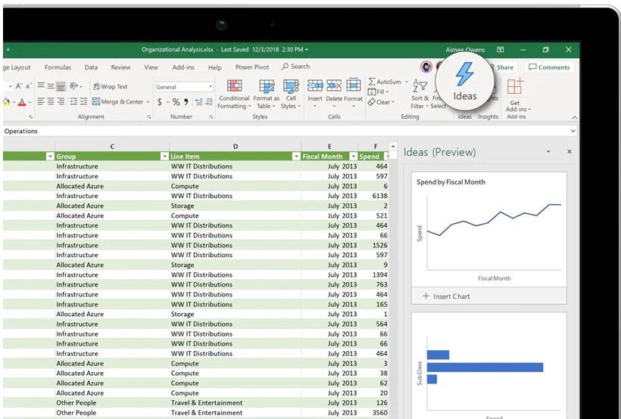

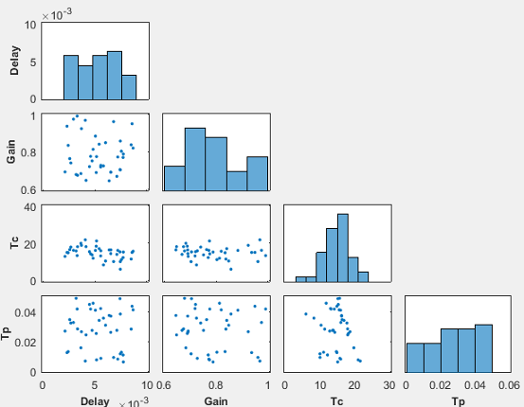
Data Preparation: Exploration & Quality Assessment
Data preparation can take up most of the time of ML project
Explore dataset and look at single examples
Get descriptive statistics (e.g., number of samples, class imbalance, mean, variance, etc.)
Visualize dataset (can also be done using unsupervised ML methods for high- dimensional data)
Assess data quality (missing data, input errors, outliers, etc.)
Data Preparation
Exploration
Quality assessment
Cleansing
Labeling
Imputation
Feature engineering

Slide 6
Building Pipelines in Python
There are many data transformation steps that need to be executed in the right order.
Fortunately, Scikit-Learn provides the Pipeline class to help with such sequences of transformations.
Existing building blocks are reused as much as possible: For example, it is easy to create a Pipeline estimator from an arbitrary sequence of transformers followed by a final estimator
The Pipeline class allows you to define a sequence of data transformation steps that should be executed in order. This is particularly useful for defining a clear sequence of preprocessing tasks, such as filling in missing values, adding custom attributes, and scaling features.
from sklearn.pipeline import Pipeline
from sklearn.preprocessing import StandardScaler
from sklearn.impute import SimpleImputer
# Assuming CombinedAttributesAdder is a custom transformer defined elsewhere
num_pipeline = Pipeline([
('imputer', SimpleImputer(strategy="median")),
('attribs_adder', CombinedAttributesAdder()),
('std_scaler', StandardScaler()),
])
# Assuming housing_num contains only the numerical attributes
housing_num_tr = num_pipeline.fit_transform(housing_num)
The numerical pipeline named num_pipeline includes three steps:
Imputation: SimpleImputer with a strategy of "median" is used to fill in missing values in numerical features with the median of each column.
Feature Engineering: CombinedAttributesAdder is used to add new features, by combining existing ones in some meaningful way.
Scaling: StandardScaler is applied to standardize the numerical features by removing the mean and scaling to unit variance.

Slide 7
Full Pipeline with Column Transformation
The ColumnTransformer is a versatile tool that enables you to apply different transformations to columns of different data types within the same dataset. It's especially handy when working with pandas DataFrames, where you often deal with heterogeneous data.
from sklearn.compose import ColumnTransformer
from sklearn.preprocessing import OneHotEncoder
num_attribs = list(housing_num)
cat_attribs = ["ocean_proximity"]
full_pipeline = ColumnTransformer([
("num", num_pipeline, num_attribs),
("cat", OneHotEncoder(), cat_attribs),
])
housing_prepared = full_pipeline.fit_transform(housing)
The full_pipeline combines the numerical pipeline with processing for categorical features:
Numerical Sub-Pipeline: The num_pipeline is applied to the list of numerical attributes (num_attribs), which is dynamically obtained from the housing_num DataFrame. This ensures that all numerical features go through imputation, feature engineering, and scaling.
Categorical Features: The OneHotEncoder is used to encode the categorical feature "ocean_proximity". One-hot encoding converts categorical values into a form that could be provided to ML algorithms to do a better job in prediction.

Slide 8

Key Takeaways
Modularity: This approach modularizes the preprocessing steps, making the code cleaner, more interpretable, and easier to maintain.
01
Reusability: The pipelines ensure that the same preprocessing steps applied during training are identically applied when making predictions with new data, which is critical for model performance.
02
Handling Heterogeneous Data: ColumnTransformer allows different preprocessing pipelines to be applied to numerical and categorical columns, making it a powerful tool for datasets with diverse data types.
03

